Slide 1
Object Detection with YOLO

Slide 2
What about YOLO
Introduction:
The YOLO (You Only Look Once) algorithm is a popular real-time object detection algorithm that was first introduced in 2015 by Joseph Redmon et al. Its primary goal is to detect objects of different classes in an image or a video stream with high accuracy and speed. Over the years, there have been several versions of the YOLO algorithm, each with different improvements and advancements. In this presentation, we will discuss the different versions of the YOLO algorithm and their key features.

Slide 3
Versions of YOLO
02
01
03
04
The first version of the YOLO algorithm, also known as YOLOv1, was released in 2015. This version was based on the Darknet framework and was designed to detect objects in real-time on a GPU. YOLOv1 divided the input image into a grid of S x S cells and predicted the object class and bounding box for each cell
The second version of the YOLO algorithm, also known as YOLOv2, was released in 2016. YOLOv2 addressed some of the limitations of YOLOv1, such as low accuracy and difficulty in detecting small objects. It introduced several improvements, including the use of batch normalization and anchor boxes for better object localization.
The third version of the YOLO algorithm, also known as YOLOv3, was released in 2018. YOLOv3 introduced several advancements in object detection, including the use of a feature pyramid network for multi-scale feature extraction and the use of residual blocks for improved feature learning
The fourth version of the YOLO algorithm, also known as YOLOv4, was released in 2020. YOLO v4 introduced several improvements over YOLOv3, including the use of a larger network architecture, improved anchor box clustering, and a new training methodology called Mish activation.

Slide 4
We used YOLO V8 in our project
Introducing Ultralytics YOLOv8, the latest version of the acclaimed real-time object detection and image segmentation model. YOLOv8 is built on cutting-edge advancements in deep learning and computer vision, offering unparalleled performance in terms of speed and accuracy. Its streamlined design makes it suitable for various applications and easily adaptable to different hardware platforms, from edge devices to cloud APIs.
NOTE:
Ultralytics : it only exists in YOLO v8

Slide 5
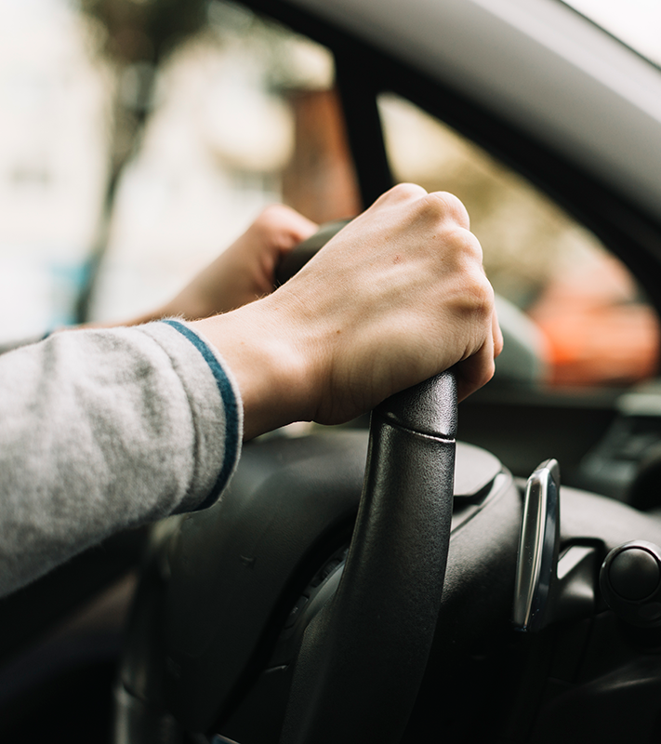
Roboflow
Roboflow is a cloud-based computer vision platform that provides tools and infrastructure for training, deploying, and managing machine learning models. It simplifies the process of data preparation, model training, and deployment and provides pre-built models and templates for common computer vision tasks. Roboflow is also focused on data privacy and security, making it a reliable and secure platform for building computer vision applications.
HOME

Slide 6
Roboflow
Roboflow is an end-to-end computer vision platform that helps you
* collaborate with your team on computer vision projects
* collect & organize images
* understand and search unstructured image data
* annotate, and create datasets
* export, train, and deploy computer vision models
* use active learning to improve your dataset over time

Slide 7
license-plates-f8vsn
No. of Samples: 1084 & No. of Classes: 2
Plates and Cars are annotated in YOLOv8 format.
The following pre-processing was applied to each image:
* Auto-orientation of pixel data (with EXIF-orientation stripping)
* Resize to 416x416 (Stretch)
Dataset

Slide 8
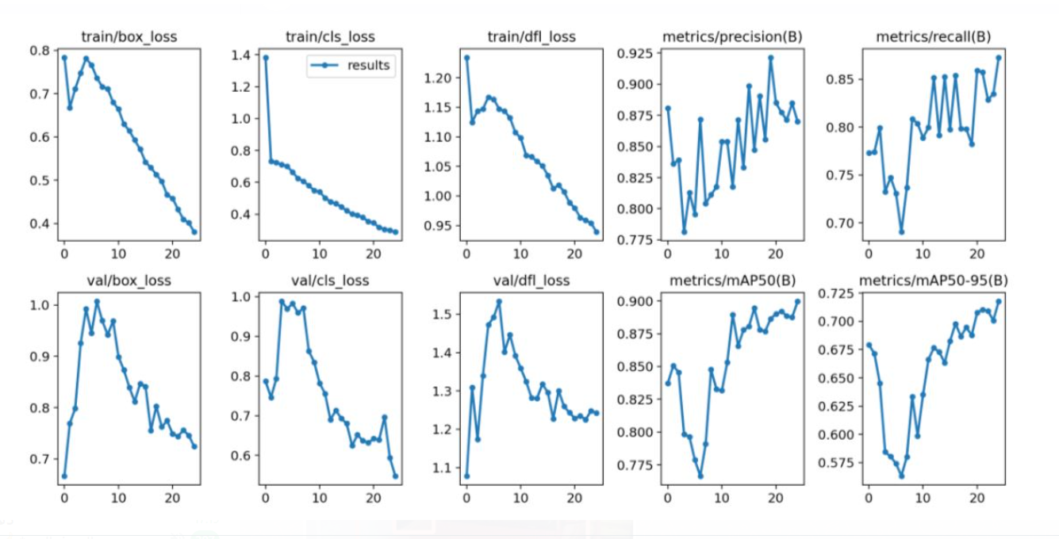
Learning rate

Slide 9
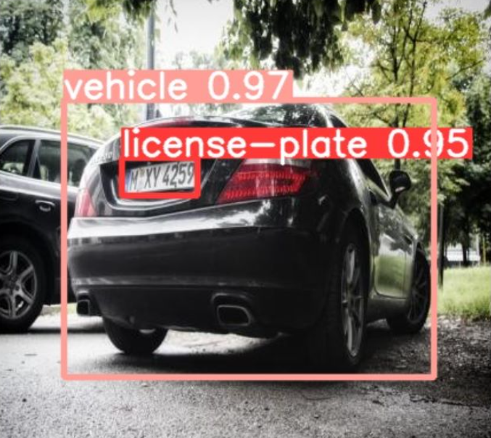
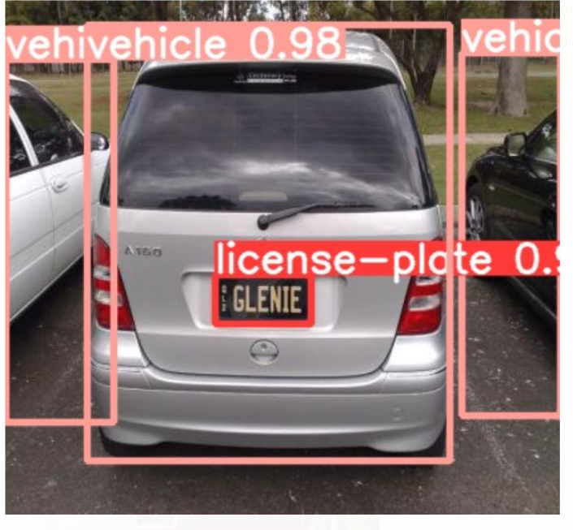
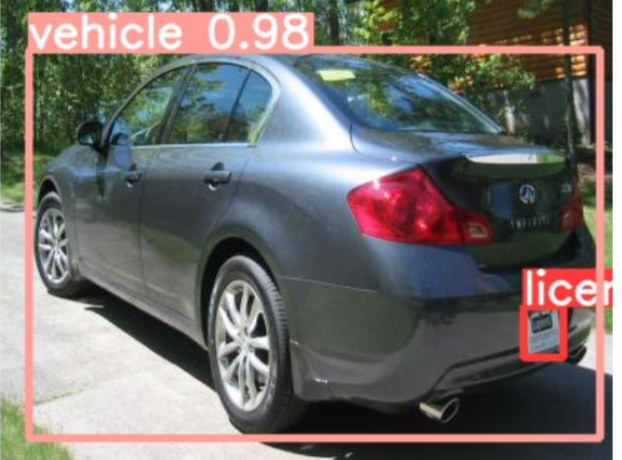
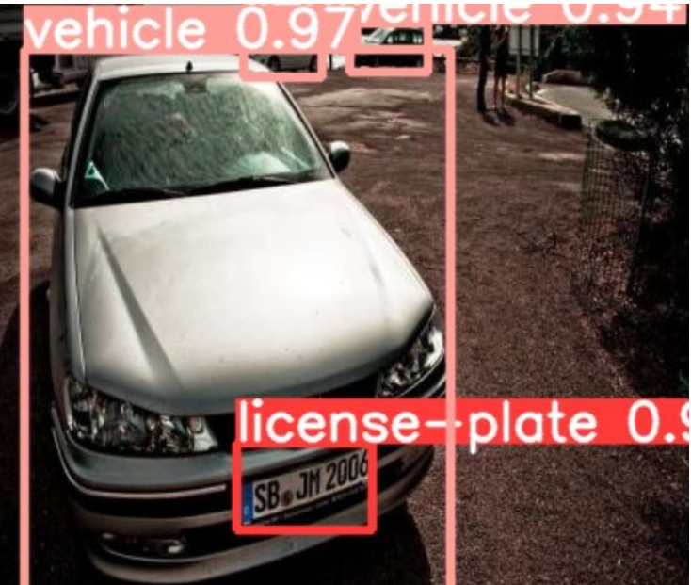

Slide 10
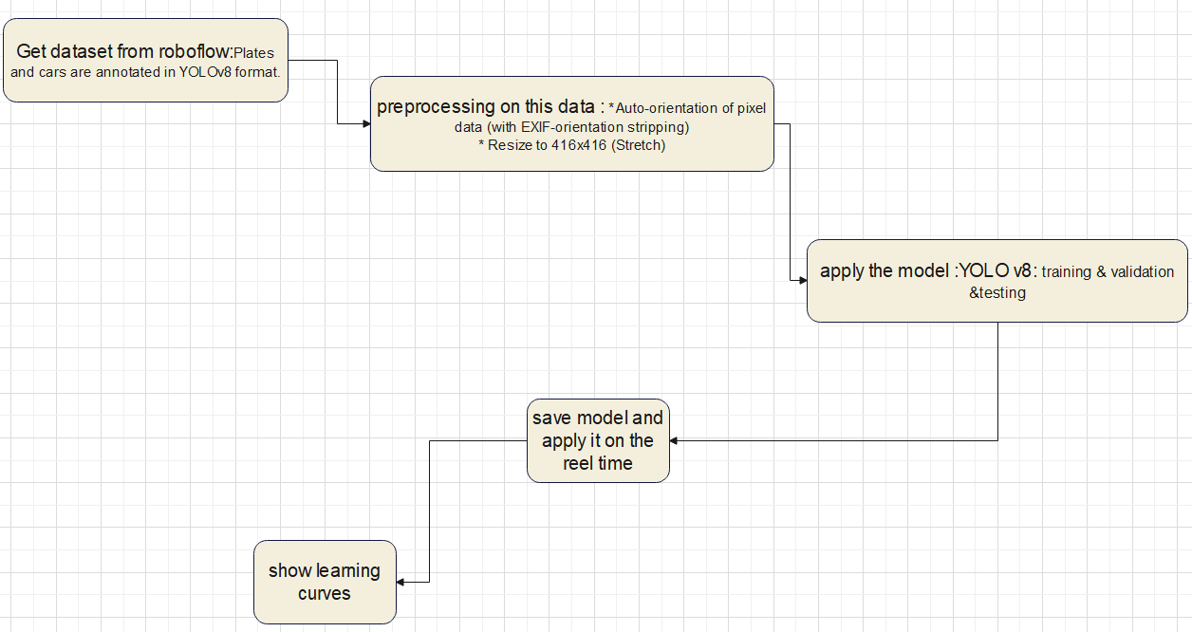
The block diagram

